Slide 1
Substitute Motion for Article 12
Presented by
Eugene Benson, Precinct 10
Susan Stamps, Precinct 3
A Balanced Approach for a Healthier Arlington

Slide 2
Overview
Artificial Turf Study Committee
Report before Spring 2024 Town Meeting
One-year moratorium on artificial turf on town owned land
  Exempts Arlington High School
  Town Meeting can lift the moratorium earlier

Slide 3
A Balanced Committee of Stakeholders
7 Voting Members
2 Non-voting Members
  Conservation Commission
  Park and Recreation Commission
  Capital Planning Committee
  Envision Arlington
  Director of Health and Human Services
  Town Meeting Member
  Town Resident
Town’s Environmental Planner / Conservation Agent
Town’s Recreation Director

Slide 4
A Fair Committee
Conflict of interest requirements for each committee member:
  No legal involvement – for or against artificial turf
  No involvement with artificial turf industry
  No involvement with artificial turf trade groups or lobbyists

Slide 5
Committee Responsibilities
Artificial turf review and report: health, safety, environmental impacts, mitigation, and natural and artificial turf fields compared
Report findings/recommendations at least 30 days before Spring 2024 Town Meeting
  or to an earlier Town Meeting if the report is ready earlier

Slide 6
A Short One-Year Moratorium
Moratorium on the construction or installation of artificial turf on Town property in effect from now until dissolution of the 2024 Town Meeting
  unless there is a vote of Town Meeting for earlier termination or to extend
  Arlington High School (including Peirce Field) is exempt (prior contractual obligations)
  A one-year moratorium runs concurrent with the time given the Committee to report to Town Meeting and the Select Board

Slide 7
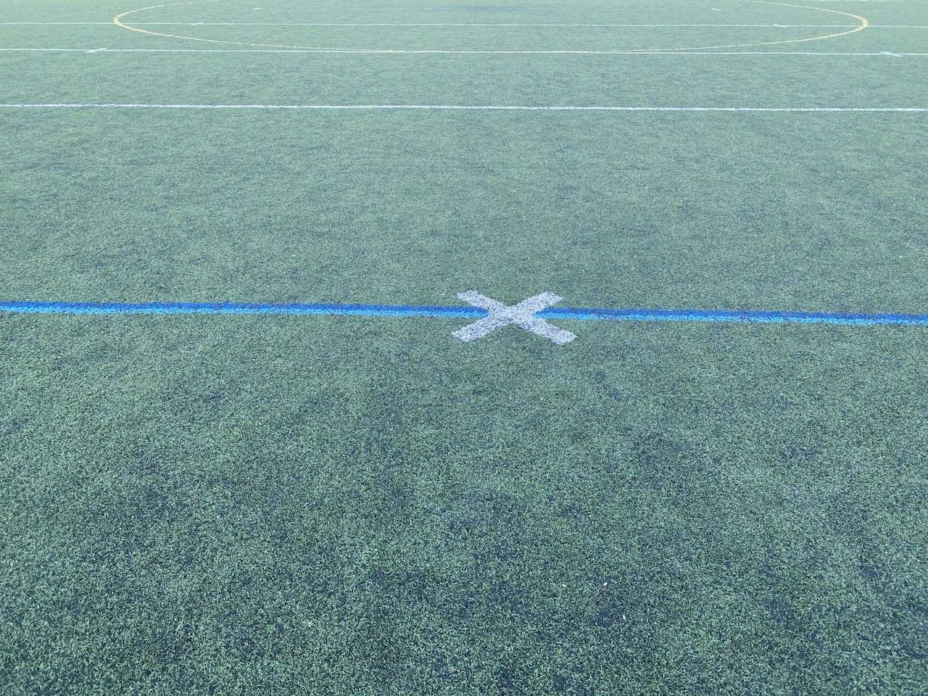
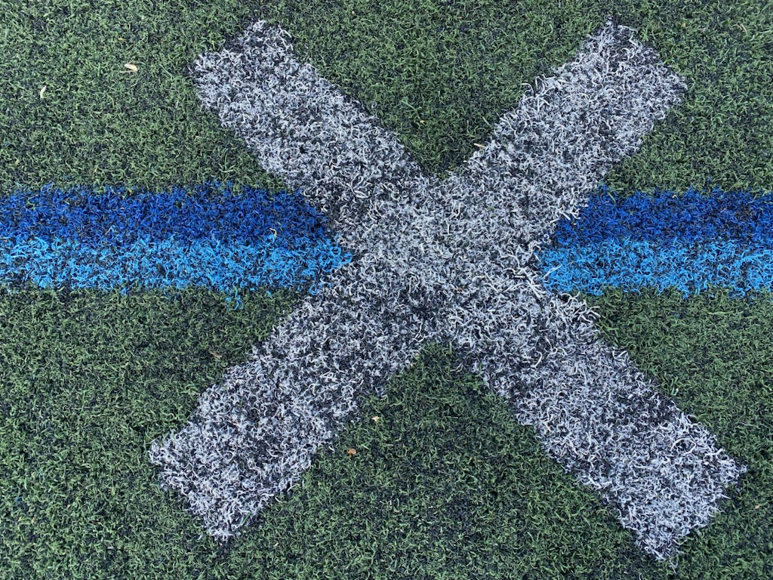
Why?
Arlington Catholic High
Artificial Turf Field
Black Crumb Rubber Bits
Covering the White X

Slide 8
Why?
Why a Study Committee?
Why a one-year moratorium?
Because there is disagreement about the pros and cons of artificial turf fields for the town
To create a process for making an informed decision
To give the Study Committee the time to do its work and so the town can act with the information the Committee provides
This is not a vote for or against any project that may be proposed for Poet’s Corner. That vote will occur when the town presents a proposal for Poet’s Corner to Town Meeting this fall or later.

Slide 9
Please vote YES on the
Benson-Stamps Substitute Motion
so together we can create
a Healthier Arlington

