Slide 1
Zero Waste
Committee
Report to Town Meeting
2023

Slide 2
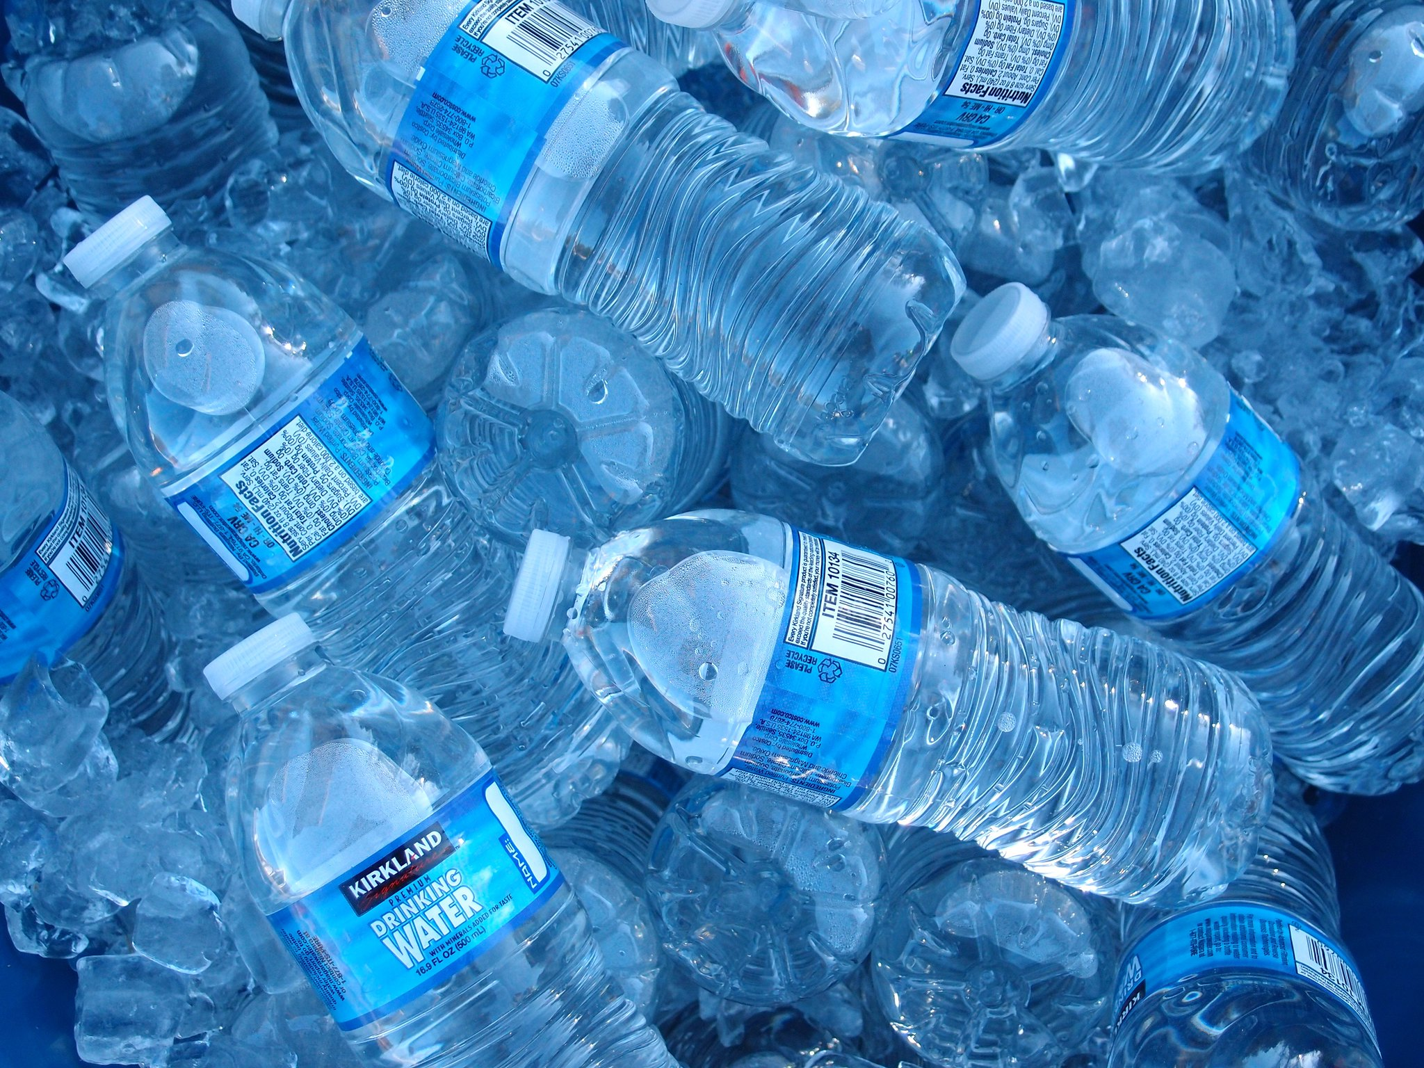
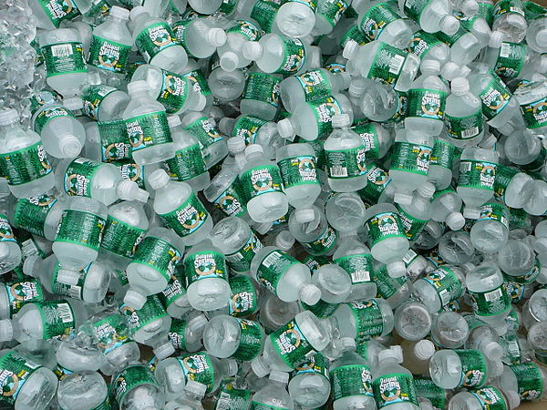
Single-Use Plastic Water Bottle Ban
Overwhelmingly (182 votes) passed 2022 ATM
Our arguments for the ban were:
The bottles have a low recycling rate - consumed away from home, no deposit
Est more than 700,000 dry 12 oz sold annually in Arlington
Thin-walled and break down quickly when littered
Arlington’s MWRA tap water is a great alternative

Slide 3
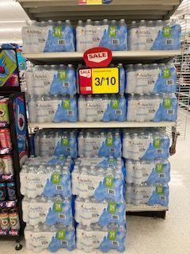
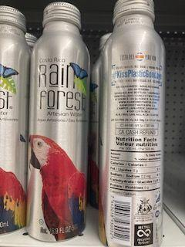
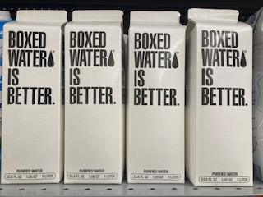
Single-Use Plastic Water Bottle Ban
700,000 12-oz bottles in 24-case packs have been replaced at Arlington retailers
Aluminium bottles and cans have replaced plastic water bottles, but in smaller packs
Good news for single use plastic waste reduction
Still no MA deposit on water
Water sold in paperboard containers, marketed as eco-friendly is becoming more common
Confusing to consumer and not recyclable

Slide 4
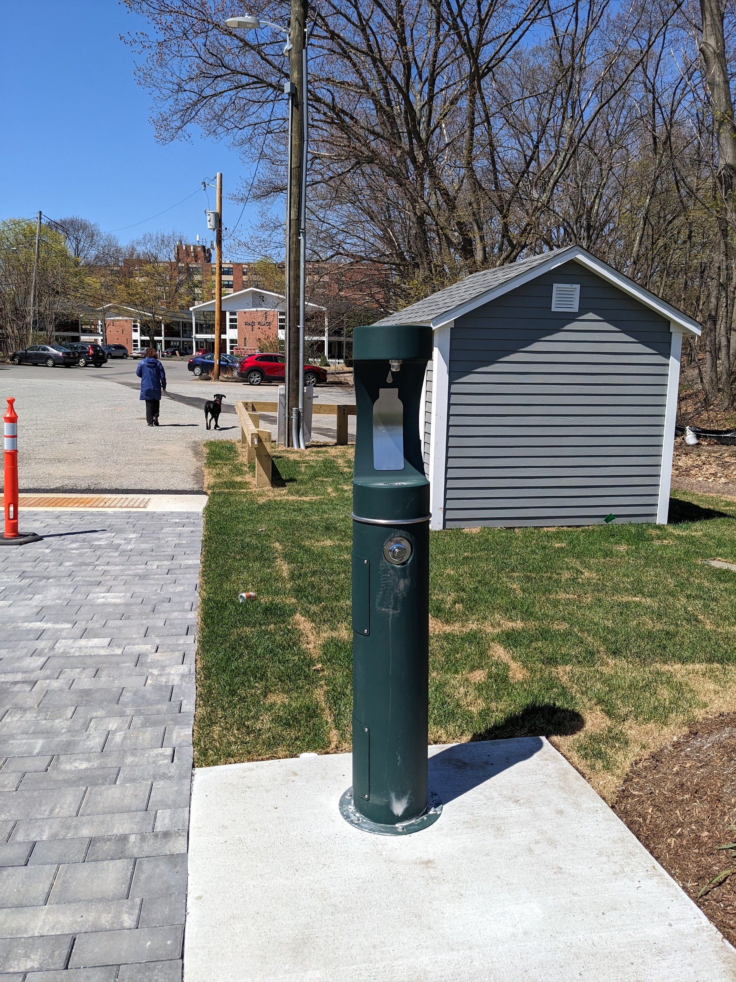
Plastics Reduction Subcommittee
Arlington On Tap
Advocating, planning, and implementing water bottle filling stations around town
Hurd field has first new water filling station!
No Plastic, Please
Restaurant-goers provided single use plastic items only by request. Win - win
zerowastearlington.org promotes participating restaurants

Slide 5
Legislative Subcommittee
Tracking waste and recycling-related legislation in the State House
Article 64 - Producer Responsibility resolution to 2023 TM
Hope you support it
Shifts burden to consumer product manufacturers
Expanding the MA bottle bill
Continues to be defeated at the State House.
Would add non-carbonated beverages, wine bottles, energy drinks

Slide 6
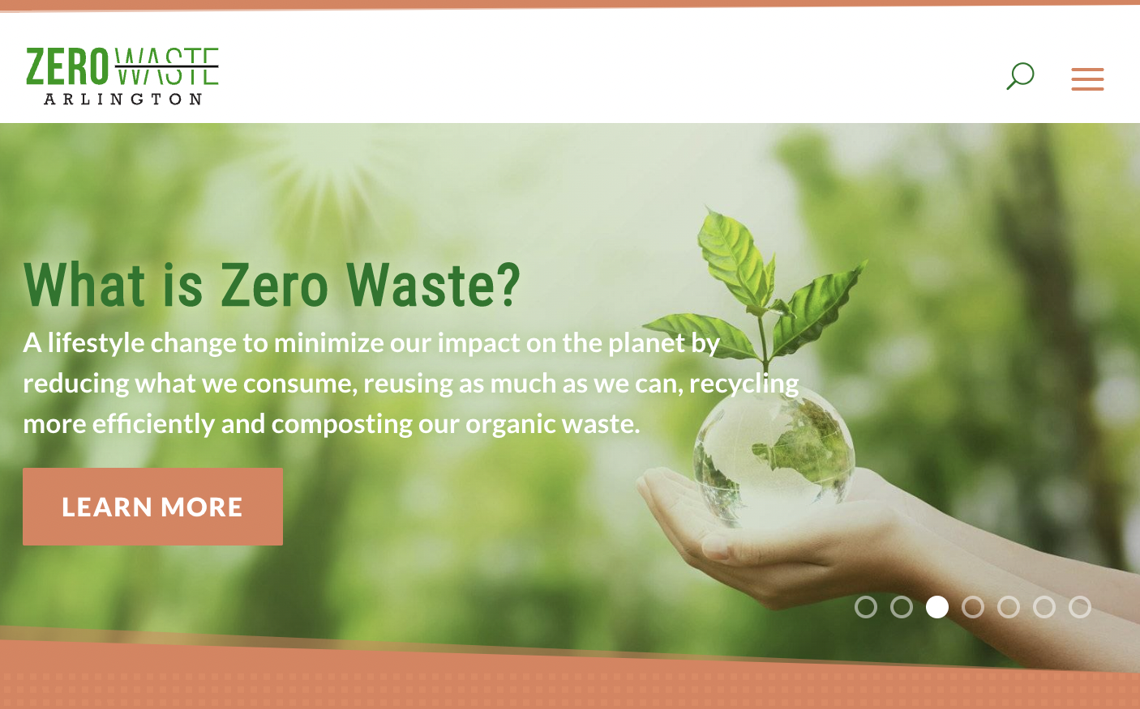
Outreach & Education
Zerowastearlington.org
launched July 2022 to compliment our Town web page
Over 2000 users browsing
Social Media
Facebook posting
Webinar series - Earth to Arlington
Waste Bans and Food Waste

Slide 7
Solid Waste - household waste reduction
Textile diverted from waste stream
371,765 lbs through the Bay State Textile program earning Arlington Schools $18,588
Solid Waste Hauled
11,302 tons of solid waste and 4,717 tons of recyclables
Reuse & Recycle Center
Very popular along with the newly opened Swap Shed!
Processes large plastics, Styrofoam, electronics

Slide 8
Learn More
Check out our website
Follow us on Facebook
Join our email list
Come to our meetings - 4th Thursday of every month
We are always looking for volunteers!

