Slide 1
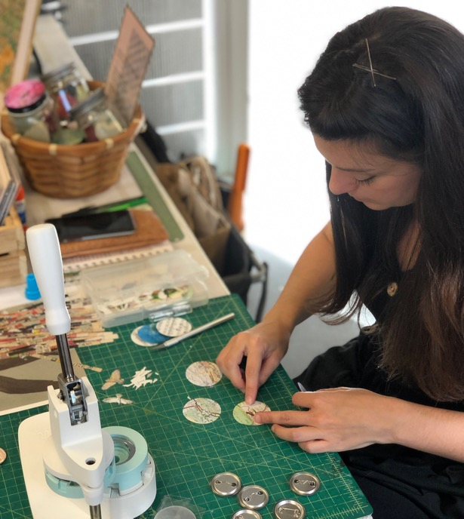
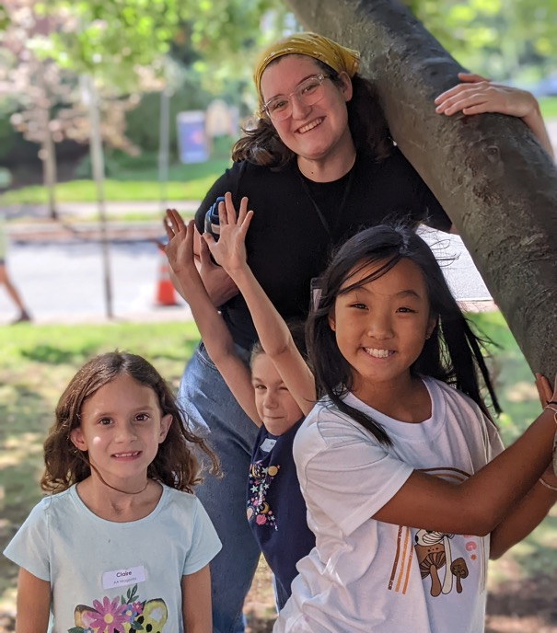
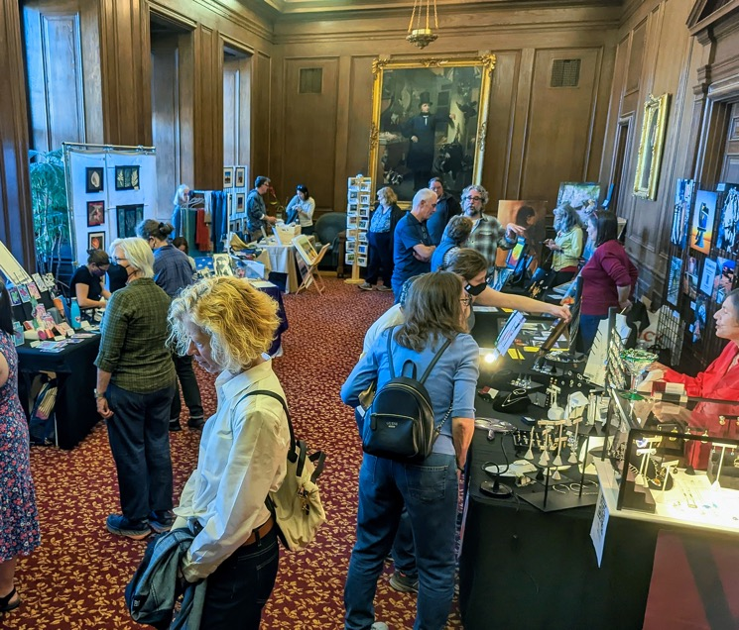
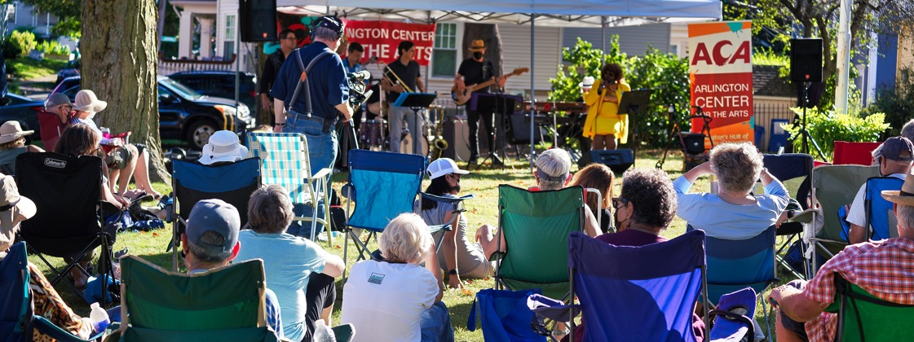

Slide 2
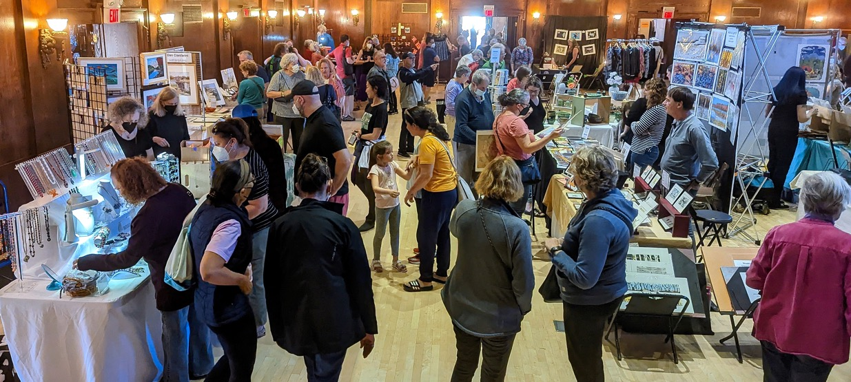
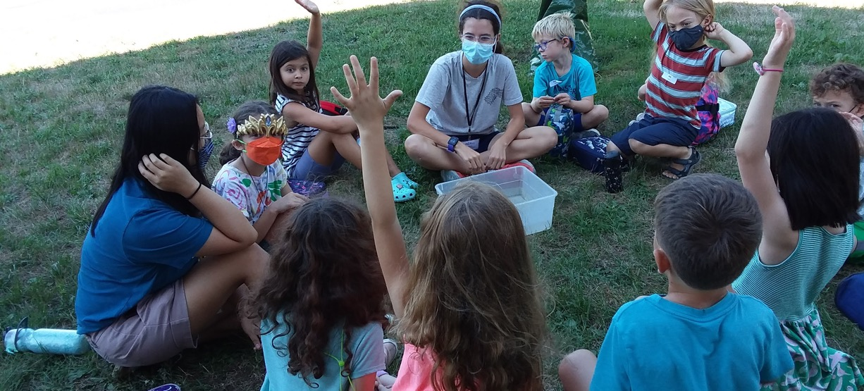
ACA’s Annual Impact
750 Students of All Ages Served in Year-round Classes
1,250 Children & Teens Enrolled in Vacation Arts Camps
80 Instructors Employed
30 Counselors Hired
18 Teen Interns Trained
More that 8,000 Arlington Porchfest Participants
2,000+ Attendees at Arlington Open Studios

Slide 3
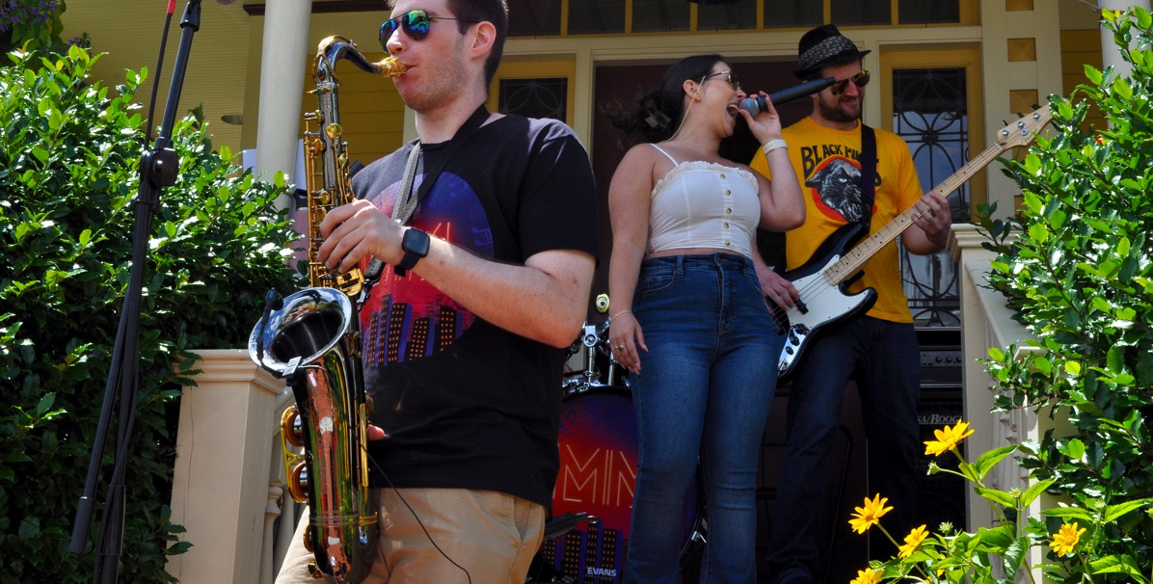
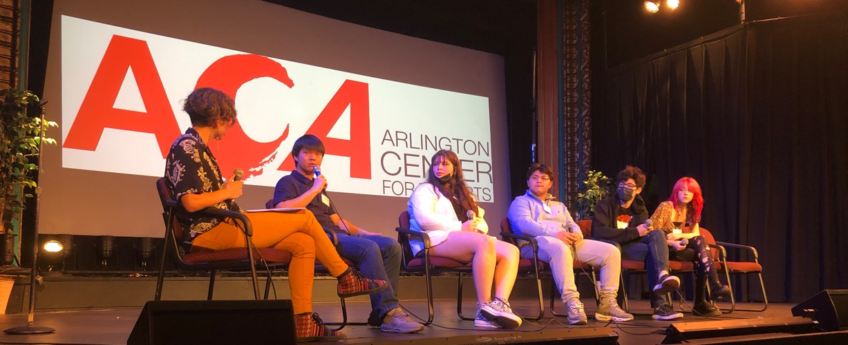
SAVE THE DATE!
On display through June 8: REUNION: 10 Iranian Artists 10 Years Later in the Shaira Ali Gallery
June 13 @ 6:30pm: Teen Artists on the Issues: Ceramics & Social Justice Exhibit and Panel Discussion at the Robbins Library
June 17, 12-6pm: Arlington Porchfest returns to our neighborhoods for its 7th year!
For more information contact:
Executive Director Tom Formicola at tom@acarts.org or (781) 648-6220

