Slide 1
ARTICLE 9
CORNER LOT REQUIREMENTS
Special Town Meeting || October 2023
Steve Revilak, ARB
Department of Planning and Community Development/Arlington Redevelopment Board

Slide 2
Article 9 - Corner Lot Requirements
Current Section 5.3.8: Requires corner lots to have setbacks that are the same as adjoining lots, even if the adjoining lots are in different districts.
Article 9: would apply B district setbacks to corner lots in B districts.
Section 5.3.16 already allows the ARB to do this. Article 9 is intended to provide clarity and predictability in the permitting process.

Slide 3
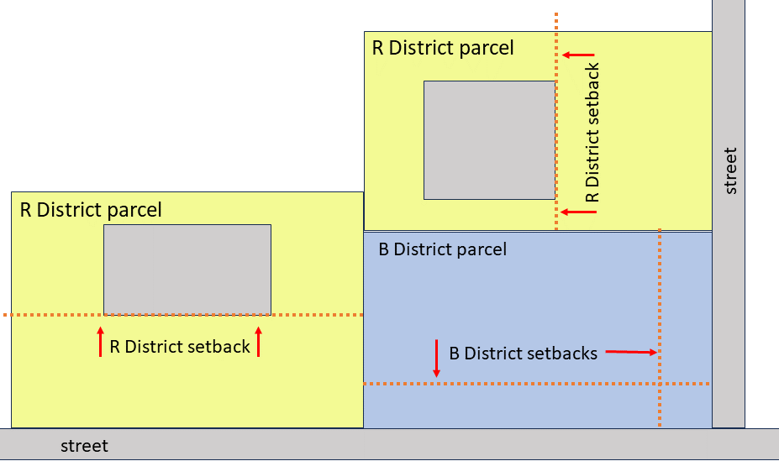
For B district parcels:

